Slide 1
CSE225 - Data Structures and Algorithms
Dynamic Array
Mosroor Mofiz Arman
1921079642
Section: 4

Slide 2
Dynamic Array
Data structure that allows you to resize its size during runtime.
Provide flexibility compared to static arrays with a fixed size.
Start with an initial size, and as elements are added and dynamically allocates more memory if needed.
If elements are removed, it may shrink in size to save memory.

Slide 3
Dynamically Allocated Data
2000
ptr
char* ptr;
ptr = new char;
*ptr = ‘B’;
std::cout << *ptr;
New is an operator
Notes:
3

Slide 4
Dynamically Allocated Data
What does new do?
Takes a pointer variable, allocates memory for it to point, and leaves the address of the assigned memory in the pointer variable.
If there is no more memory, the pointer variable is set to NULL.
Notes:
4

Slide 5
Dynamically Allocated Data
2000
ptr
‘B’
char* ptr;
ptr = new char;
*ptr = ‘B’;
std::cout << *ptr;
Notes:
5

Slide 6
Key Features of Dynamic Array
Add Element
Delete Element
Resize of Array Size

Slide 7
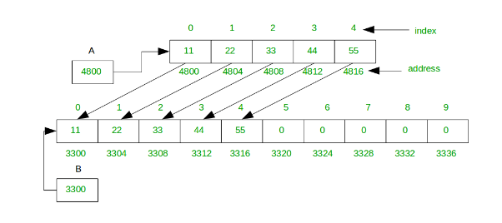
Add Element
Copying takes O(n) time, where n is the number of elements in our array.
Fixed-length array, appends only take O(1) time.
Full array, appends take O(n) time.
Double the size of the array every time, run out of space. So in most cases appending is still O(1) time, and sometimes it’s O(n) time.

Slide 8
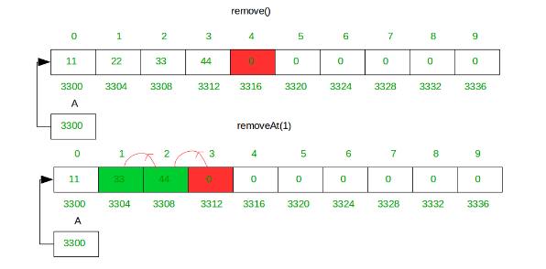
Delete Element
remove() method delete an element from end.
Simply store zero at last index .
removeAt(i) method shift all right element in the left side from the given index .

Slide 9
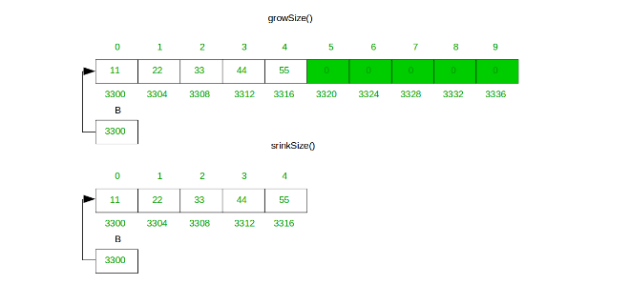
Resize of Array Size
shrinkSize() method can free up the extra memory.
Resizing is expensive because of allocating a bigger array and copy over all of the elements from the array.

Slide 10
Memory Leak
A memory leak occurs when dynamic memory (that was created using operator new) has been left without a pointer to it by the programmer, and so is inaccessible.
8
ptr
-5
ptr2
int* ptr = new int;
*ptr = 8;
int* ptr2 = new int;
*ptr2 = -5;
How else can an object become inaccessible?
Notes:
10

Slide 11
Causing a Memory Leak
8
ptr
-5
ptr2
int* ptr = new int;
*ptr = 8;
int* ptr2 = new int;
*ptr2 = -5;
ptr = ptr2;
// here the 8 becomes inaccessible
8
ptr
-5
ptr2
Notes:
11

Slide 12
Thank You

